Slide 1

PIP2001 Capstone Project
Review-4
Donor Hub
Batch Number:
Roll Number | Student Name
20211CSE0289 | BHARGAVI S
20211CSE0745 | KIRAN KUMAR KC
20211CSE0629 | RAHUL GOWDA V
Under the Supervision of,
Mr.Ramesh T
Professor / Associate Professor / Assistant Professor
School of Computer Science and Engineering
Presidency University
Name of the Program: CSE
Name of the HoD: Dr.Asif Mohammed H.B
Name of the Program Project Coordinator: Dr. Jayanthi. K.
Name of the School Project Coordinators: Dr. Sampath A K / Mr.Jerrin / Mr. Md Ziaur Rahman

Slide 2
Content
Introduction
Literature Review
Existing method Drawback
Proposed Method
Methodology/Modules
Architecture diagram
Hardware/software components
Timeline of the Project
Expected Outcomes
Conclusion
Github Link
References
Project work mapping with SDG

Slide 3
Introduction
Donor Hub is a web-based Blood Bank Donor Management System designed to connect blood donors with recipients efficiently. The platform allows secure donor registration, real-time blood request tracking, and search functionality based on blood group and location. By streamlining communication and data management, DonorHub ensures timely access to blood and improves the overall efficiency of blood bank operations.

Slide 4
Literature Review
1. S. M., D. R., D. D. S., and S. S., "Blood Donors and Blood Banks Tracking Applications," 2023 2nd International Conference on Advancements in Electrical, Electronics, Communication, Computing and Automation (ICAECA), Coimbatore, India,2023,pp.1–6.
Paper Link: https://ieeexplore.ieee.org/document/10200259
Takeaway: Demonstrates the importance of digital tracking systems to monitor donor availability and blood stock levels in real-time, enhancing traceability and operational efficiency in blood banks.

Slide 5
Literature Review
2. J. Kaur, A. Gupta, A. Tripathi, A. K. Gupta, and A. Srivastava, "RaktFlow - Blood Bank Management and Donation System," 2022 OPJU International Technology Conference on Emerging Technologies for Sustainable Development (OTCON), Raigarh, India, 2023, pp. 1–6
. Paper Link: https://ieeexplore.ieee.org/document/10113983
Takeaway: Emphasizes a user-friendly interface and donor tracking modules, illustrating how digital platforms can streamline registration and location-based donor-recipient matching.

Slide 6
Literature Review
3. D. Hawashin et al., "Blockchain-Based Management of Blood Donation," IEEE Access, vol. 9, pp. 163016–163032, 2021. Paper Link: https://ieeexplore.ieee.org/document/3133953
Takeaway: Introduces blockchain as a secure method to manage donor data and transaction logs, ensuring transparency, privacy, and trust in donation systems.

Slide 7
Existing method Drawback
Lack of Centralized Donor Information – Donor data is scattered across hospitals, NGOs, and local systems with no unified database.
Delayed Response Time – Manual processes and lack of real-time tracking slow down the blood request and delivery process.
Limited Donor Reach – Inability to search donors based on location or blood group leads to missed opportunities during emergencies.
Poor Record Maintenance – Traditional systems often lack secure, updated digital records of blood inventory and donor history.

Slide 8
Proposed Method
The proposed DonorHub system will integrate all blood donation-related services into a single digital platform for streamlined donor-recipient coordination:
Donor Registration & Management – A secure portal for donors to register, manage their availability, and update personal information.
Real-Time Blood Request Handling – Users can search for donors by city and blood group and submit blood requests instantly.
Admin Control & Reporting – Admin can manage blood groups, monitor requests, maintain donor records, and generate reports for efficient operations.

Slide 9
Objectives
To enhance the management of blood donation and availability
To connect blood donors and recipients efficiently across different locations
To provide a secure platform for storing and accessing donor information
To enable fast and accurate search based on blood group and city

Slide 10
Methodology/Modules
Module 1: Admin Panel
Manage blood groups, donor records, and user queries.
View and respond to blood requests.
Generate blood request reports and maintain secure admin access.
Module 2: Donor Panel
Donors can register, update their profiles, and manage their availability.
View incoming blood requests and respond accordingly.
Maintain secure account access with password management.
Module 3: User Panel
Search for donors based on city and blood group.
View donor contact details and send blood requests.
Access informational pages like Home, About Us, and Contact Us.

Slide 11
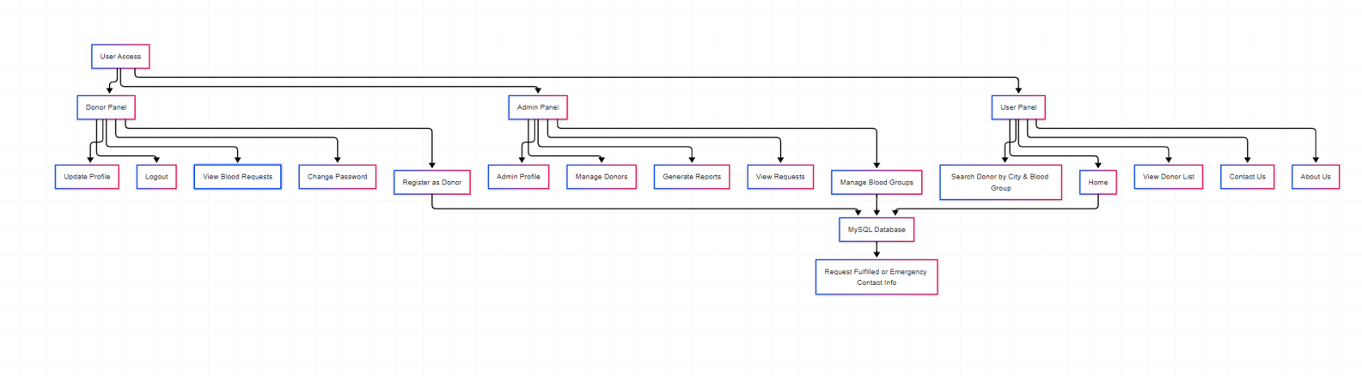
Architecture diagram

Slide 12
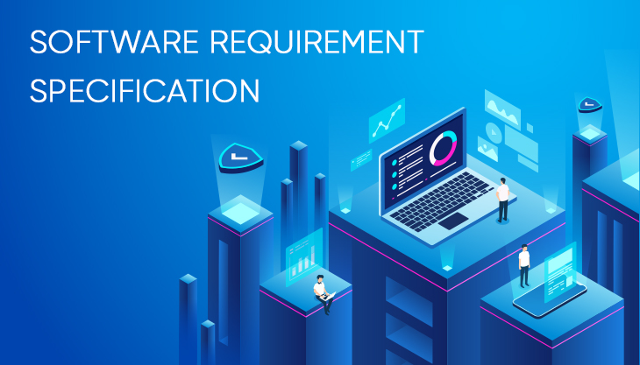
Analysis of Problem Statement (contd...)
Website
Provides donor registration and blood request services.
Offers a simple and user-friendly interface for users, donors, and admins.
Backend
Handles storage, retrieval, and processing of donor and request data.
Manages user authentication and access control.
Database
Stores donor details, blood groups, and blood request records.
Maintains contact queries and admin reports.

Slide 13

Analysis of Problem Statement (contd...)
Hardware Requirements:
Servers: For backend processing and data management.
Network Infrastructure: For communication.
User Devices: Mobile devices, tablets ,computers.

Slide 14
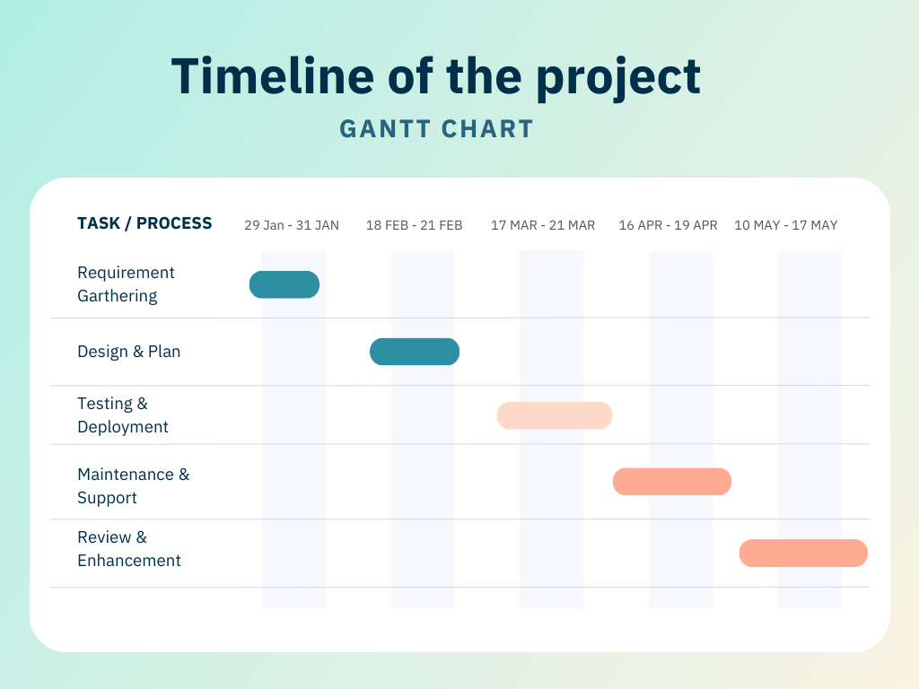
Timeline of the Project (Gantt Chart)

Slide 15
Expected Outcomes
A fully functional digital platform that facilitates and manages blood donation and request activities.
Efficient registration and management of donors, including profile updates and blood group tracking.
Timely handling of blood requests by matching them with suitable donors, ensuring quick response in emergencies.
Seamless communication between donors, requesters, and administrators via an intuitive user interface.

Slide 16
Expected Outcomes
Centralized monitoring and management of blood groups, donor data, and contact queries by the admin panel.
Enhanced transparency and traceability in blood donation processes, improving trust and user engagement.
Automated data recording and report generation for administrative decision-making and analysis.
Reduction in manual errors and paperwork through digitized workflows and real-time updates.

Slide 17
Conclusion
Donor Hub aims to transform blood donation and management by providing a centralized digital platform that connects donors, recipients, and administrators efficiently. By enabling real-time donor search, secure data handling, and streamlined communication, the system enhances the speed and reliability of blood availability. This solution contributes to more responsive, transparent, and life-saving blood bank operations.

Slide 18
Github Link
The Github link provided should have public access permission.
https://github.com/BhargaviShankar123/Blood-Bank-Donor-Management-System-using-Python-Django-and-MySQL

Slide 19
References
S. M., D. R., D. D. S., and S. S., "Blood Donors and Blood Banks Tracking Applications," 2023 2nd International Conference on Advancements in Electrical, Electronics, Communication, Computing and Automation (ICAECA), Coimbatore, India, 2023, pp. 1–6. Paper Link: https://ieeexplore.ieee.org/document/10200259
J. Kaur, A. Gupta, A. Tripathi, A. K. Gupta, and A. Srivastava, "RaktFlow - Blood Bank Management and Donation System," 2022 OPJU International Technology Conference on Emerging Technologies for Sustainable Development (OTCON), Raigarh, Chhattisgarh, India, 2023, pp. 1–6. Paper Link: https://ieeexplore.ieee.org/document/10113983
R. Elakya, M. Dhanam, B. Hemnaath, R. Dhanalakshmi, M. Gayathri, and H. B. I., "Blood Donor Management System - An Android Based Model and Implementation," 2022 Third International Conference on Intelligent Computing Instrumentation and Control Technologies (ICICICT), Kannur, India, 2022, pp. 607–614. Paper Link: https://ieeexplore.ieee.org/document/9917630
M. Kaur et al., "A Web-based Blood Bank System for Managing Records of Donors and Receipts," 2022 International Conference on Computational Intelligence and Sustainable Engineering Solutions (CISES), Greater Noida, India, 2022, pp. 459–464. Paper Link: https://ieeexplore.ieee.org/document/9844389
Q. Qian, W. Xu, W. Li, B. Wang, L. Wang, and Q. Zhou, "Accurate Detection of Chylous Blood Levels by Deep Learning," IEEE Access, vol. 10, pp. 73988–73996, 2022. Paper Link: https://ieeexplore.ieee.org/document/3189369
D. Hawashin et al., "Blockchain-Based Management of Blood Donation," IEEE Access, vol. 9, pp. 163016–163032, 2021. Paper Link: https://ieeexplore.ieee.org/document/3133953
H. D. Das, R. Ahmed, N. Smrity, and L. Islam, "BDonor: A Geo-localised Blood Donor Management System Using Mobile Crowdsourcing," 2020 IEEE 9th International Conference on Communication Systems and Network Technologies (CSNT), Gwalior, India, 2020, pp. 313–317. Paper Link: https://ieeexplore.ieee.org/document/9115776
P. A. J. Sandaruwan, U. D. L. Dolapihilla, D. W. N. R. Karunathilaka, W. A. D. T. L. Wijayaweera, W. H. Rankothge, and N. D. U. Gamage, "Towards an Efficient and Secure Blood Bank Management System," 2020 IEEE 8th R10 Humanitarian Technology Conference (R10-HTC), Kuching, Malaysia, 2020, pp. 1–6. DOI: 10.1109/R10-HTC49770.2020.9356980 Paper Link: https://ieeexplore.ieee.org/document/9356980
P. Govender and A. E. Ezugwu, "A Symbiotic Organisms Search Algorithm for Optimal Allocation of Blood Products," IEEE Access, vol. 7, pp. 2567–2588, 2019. DOI: 10.1109/ACCESS.2018.2886408 Paper Link: https://ieeexplore.ieee.org/document/8633941
T. Palaniappan, K. G. Mahalakshmi, and K. Vidhya, "Cloud-Based Blood Bank System Using Blockchain for Transparent Donation and Distribution," 2023 International Conference on Computational Intelligence and Sustainable Engineering Solutions (CISES), Greater Noida, India, 2023, pp. 112–117. DOI: 10.1109/CISES58789.2023.10122876 Paper Link: https://ieeexplore.ieee.org/document/10122876

Slide 20
Publication Details
UGC Approval : UGC Approved Journal No: 43602
Registration ID : IJRAR_310556
Paper ID : IJRAR25B1365
Title of Paper : Blood Bank Donor Management System
Impact Factor : 7.17 (Calculate by Google Scholar) | License by Creative
Published in : Volume 12 | Issue 2 | April 2025
Publication Date : 2025-04-13 03:51:39
Page No : 789-792
Published URL : http://www.ijrar.org/viewfull.php?&p_id=IJRAR25B1365

Slide 21
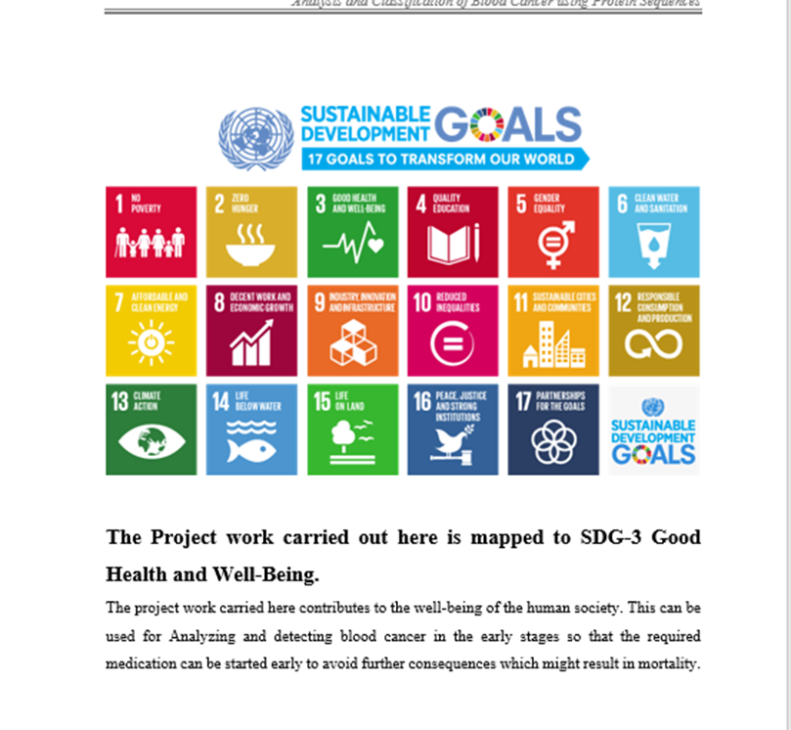
Project work mapping with SDG
SDG 3: Good Health and Well-Being – Ensures timely access to safe blood, improving health outcomes and saving lives.
SDG 11: Sustainable Cities and Communities – Strengthens emergency medical support systems in urban and rural areas through efficient donor-recipient connectivity.
SDG 16: Peace, Justice, and Strong Institutions – Promotes transparency, accountability, and efficiency in managing donor records and blood distribution processes.

Slide 22


